Slide 1
L’émergence d’un nouveau monde arabe
The emergence of a new arab world
Elza Maalouf

Slide 2

Emergence of The Arab World
Creating a Globally Informed, Uniquely Arab Governance System

Slide 3
FLOW
Why is the Arab Youth taking this Momentous Leap
How Arab Countries can establish Infant Democracies
Why creating a viable Palestinian State can stabilize the region
How this Systemic Framework contributes to Global emergence

Slide 4
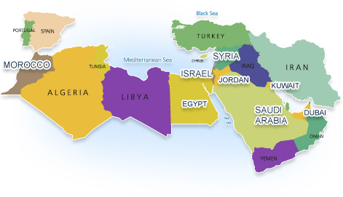
Why is the Arab Youth taking this Momentous Leap.
SPHERES of
INFLUENCE
SYRIA
SAUDI
ARABIA
EGYPT
MOROCCO
PALESTINE

Slide 5
Factors Contributing to The Arab Spring
Globalized Arab Youth with access to the internet who broke the barrier of fear from dictators – 60 % of Population
Price of Food went up 300% in a culture that survives on a $1/day- 65%
Lack of employment opportunities for educated young men and women under 25 - 60%
The spread of the Feudal mindset of Islam vs. Enterprising Islam

Slide 6
How Arab Countries can establish Infant Democracies

Slide 7
Natural Design Principles
Find the “Indigenous Intelligence in societies.
Treat Deep Causes & Surface Level Symptoms Simultaneously
Follow Natural Contours of Organizations, Cultures, Societies
Flow with the Inevitability of Change
  Fresh Solutions
  Practical, Functional
  Future Visions, Future “Pull”
Address Capacities of the People
  To Think and Act Differently
Mesh Bottom Up and Top Down Initiatives
  Integrate their Efforts
Address What Matters Most to People
  Not Trivia or Peripheral Issues
Tailor to Unique DNA Type-Code of Social Entity, Group or Culture

Slide 8

Indigenous Intelligence
Using the Value-Systems framework I redefined the meaning of indigenous to include the “unique expression” of the complex intelligences within each culture.

Slide 9
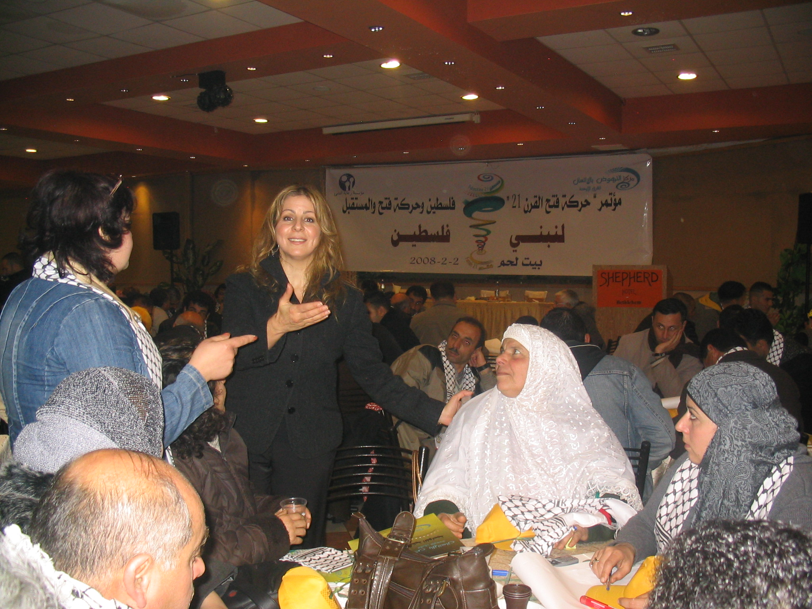
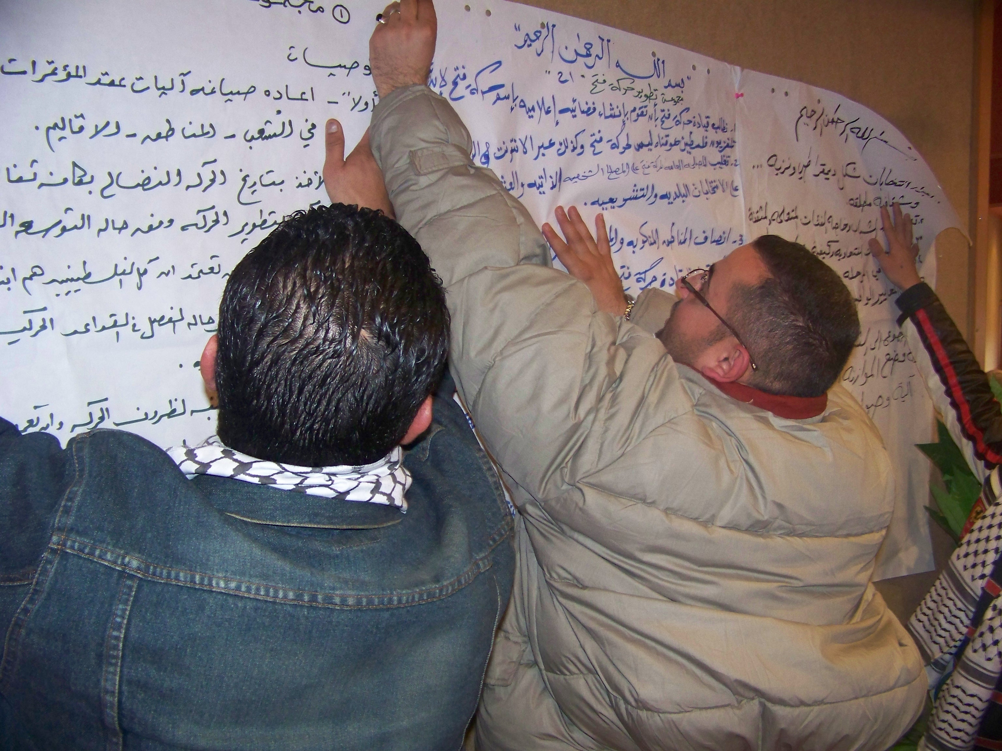
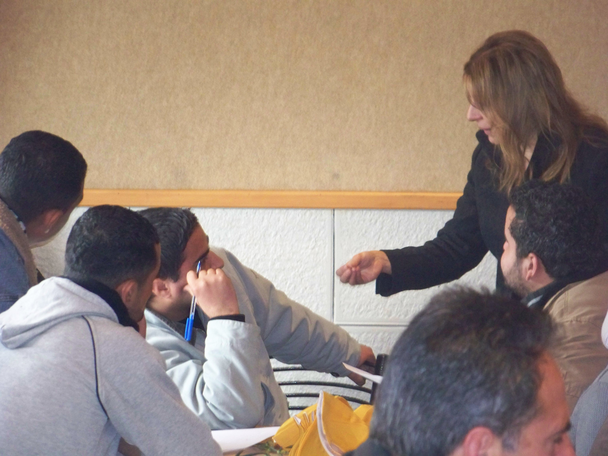
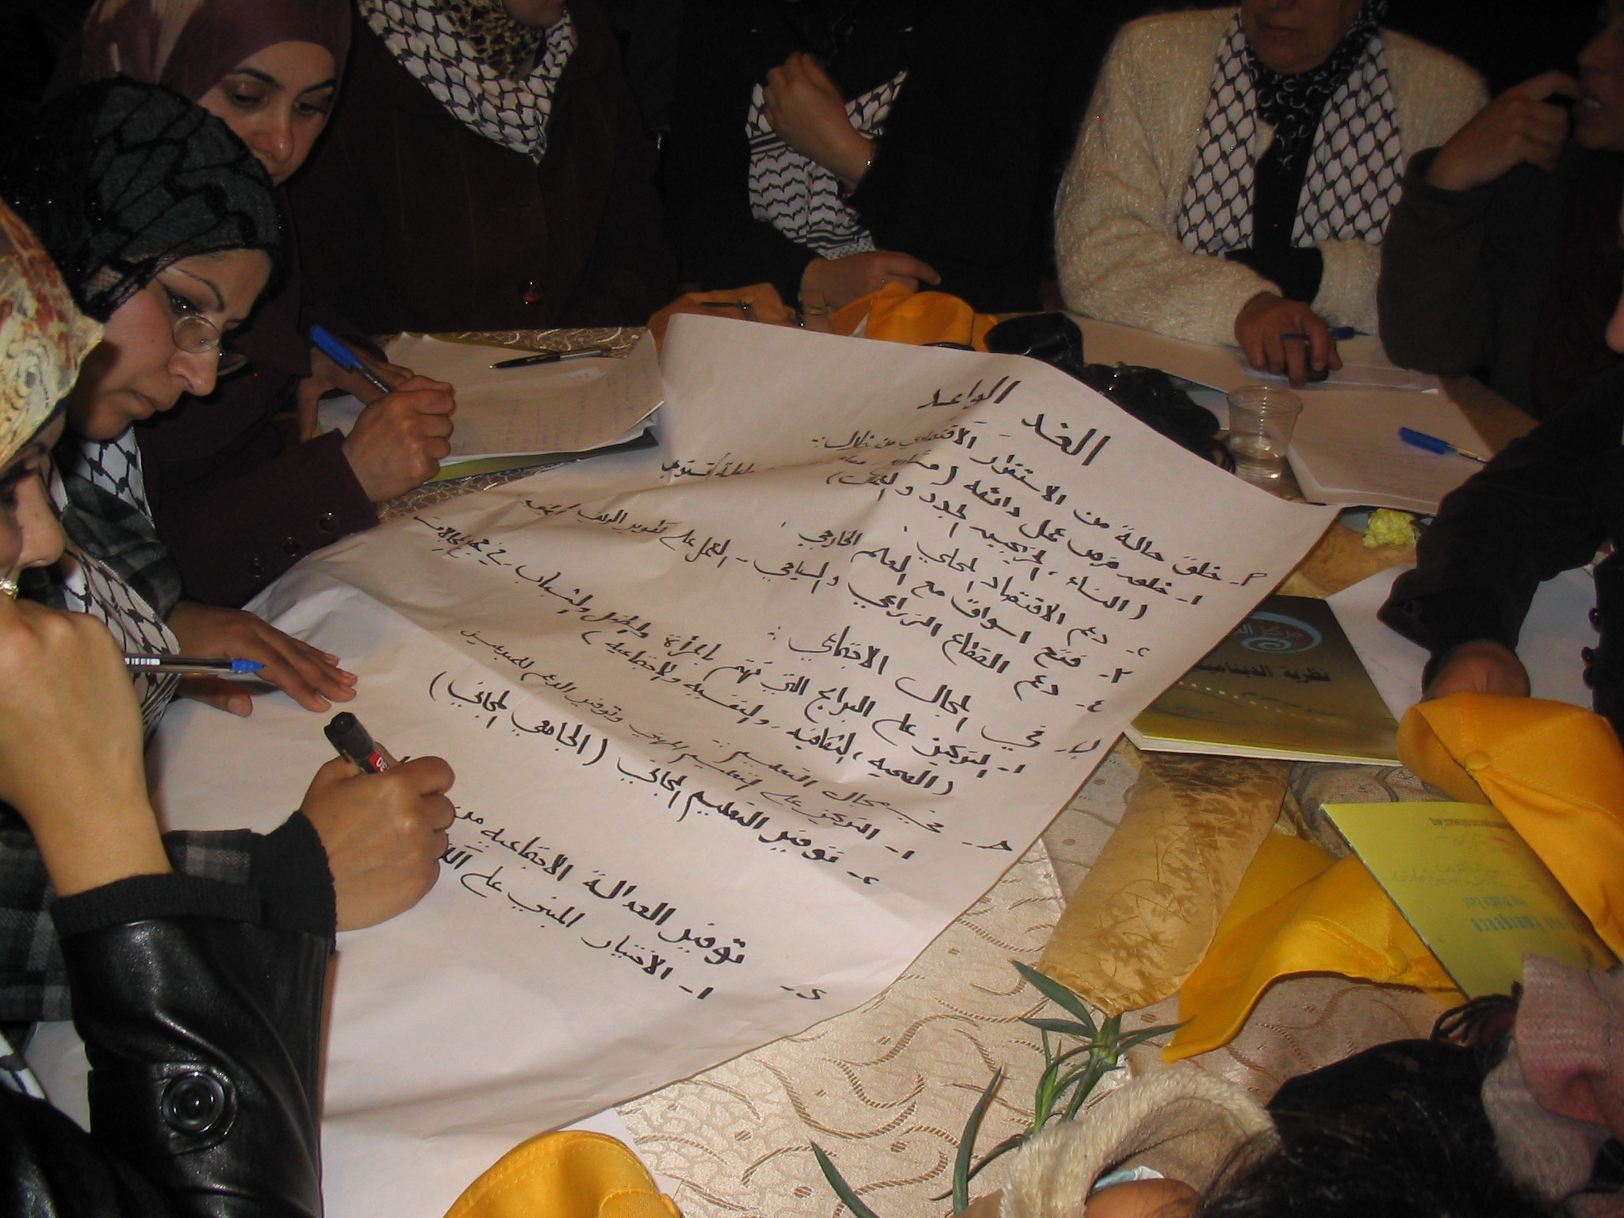
Nation Building Conference Bethlehem, PA 2/2/2008

Slide 10
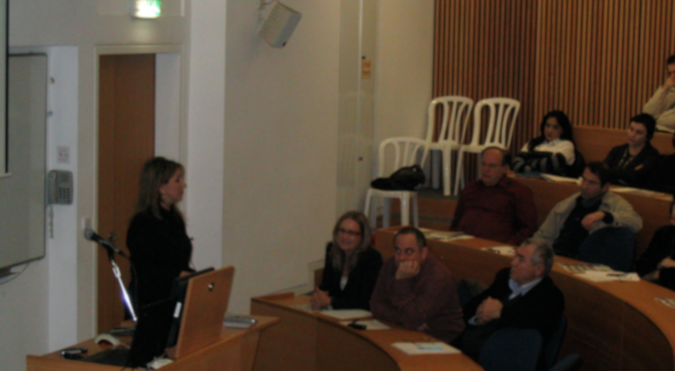
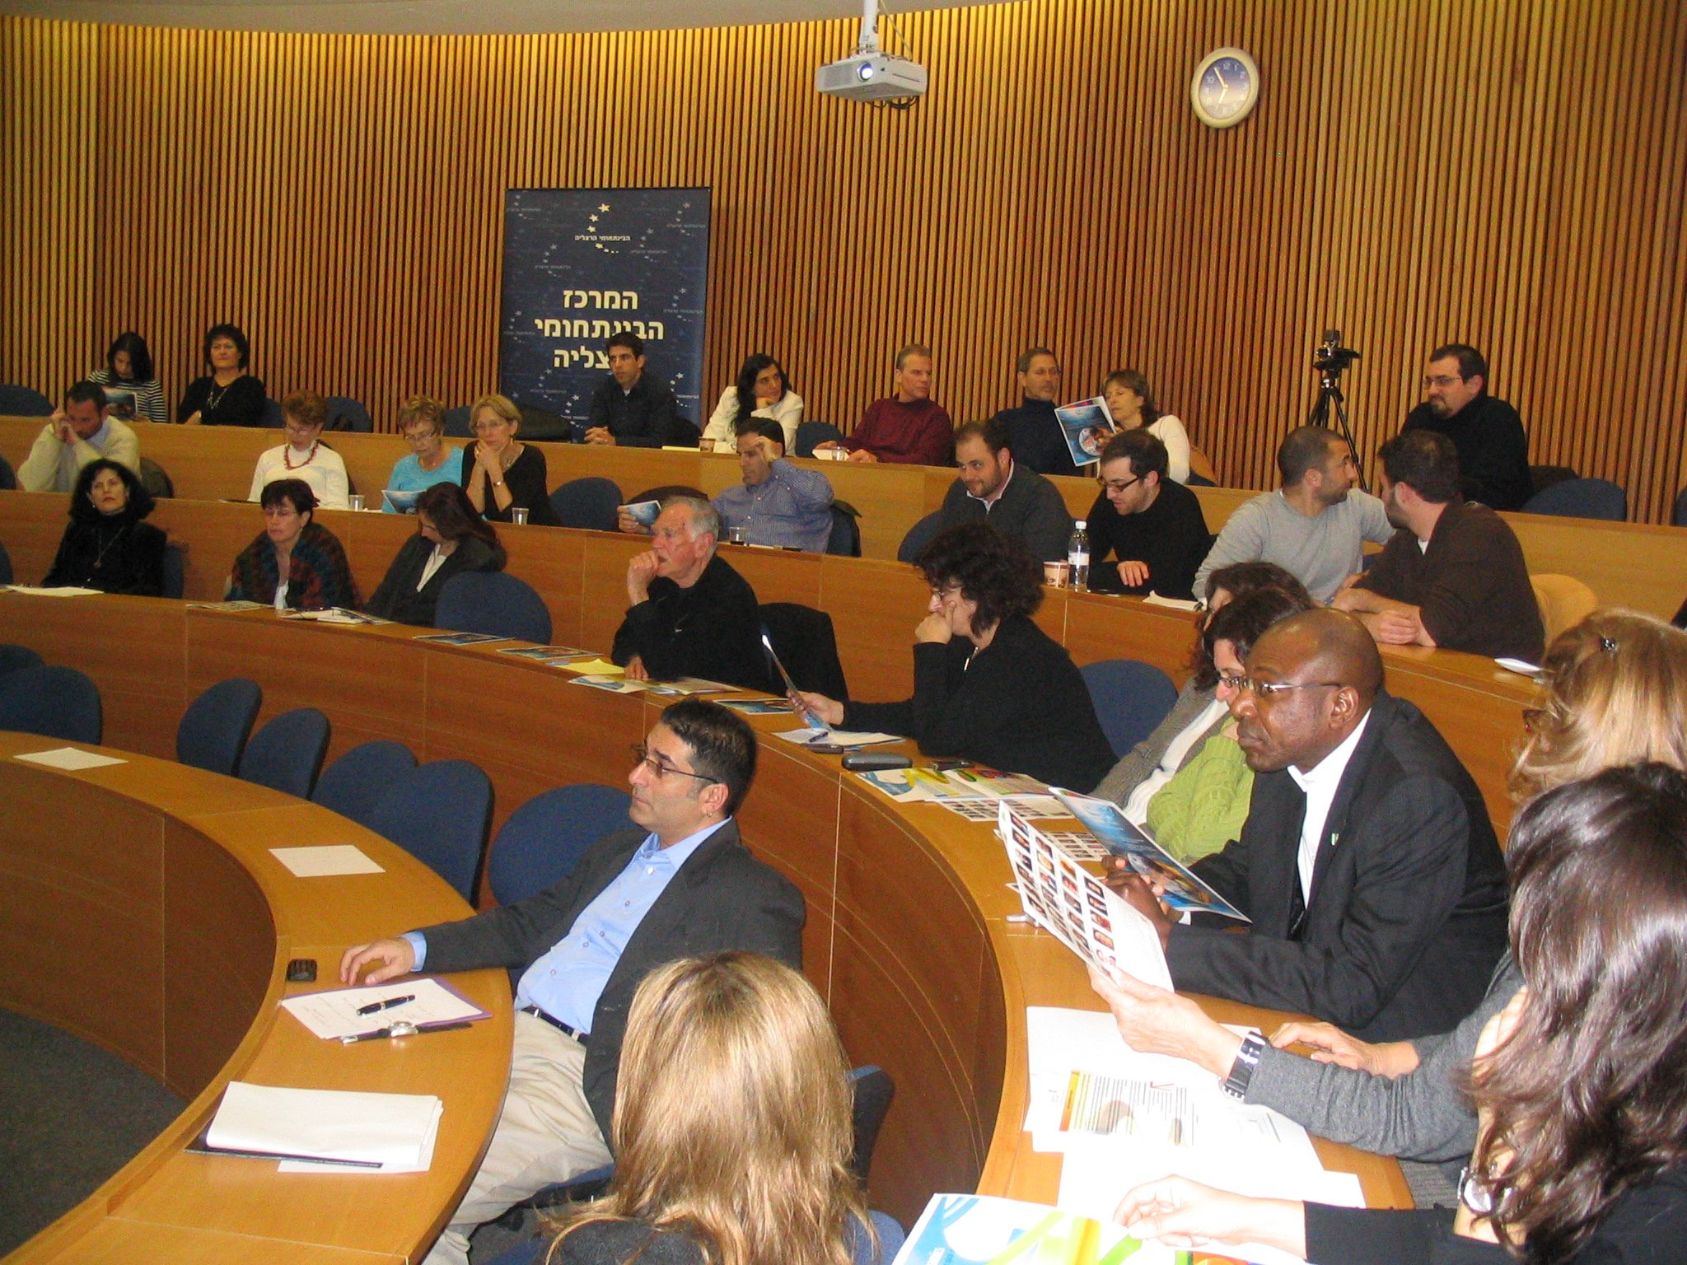
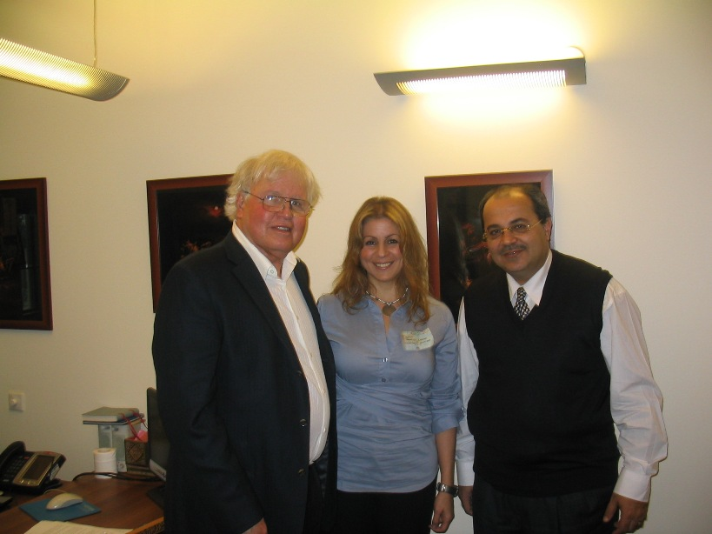
Tel Aviv University
Kenesset- Jerusalem
Arab-Israeli Deputy Speaker

Slide 11
Arab-Style Democracy
Study the profiles of the citizens in the democracy seeking countries
Identify each country's zones of synergy
Study the Forms of Governance that work
Pursue a Systemic Approach to Economic Development
Maximize the use of Technologies that Anticipate Change (RAHS- Singapore)
Notes:
Risk Assessment and Horizon Scanning

Slide 12
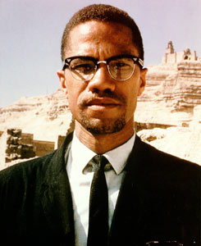
Evolution of Malcolm X as a Role Model for Young Arabs
Created Muslim Mosque Inc.
Why not Mandela, Ghandi or Martin Luther King?

Slide 13
Why creating a viable Palestinian State can stabilize the region

Slide 14
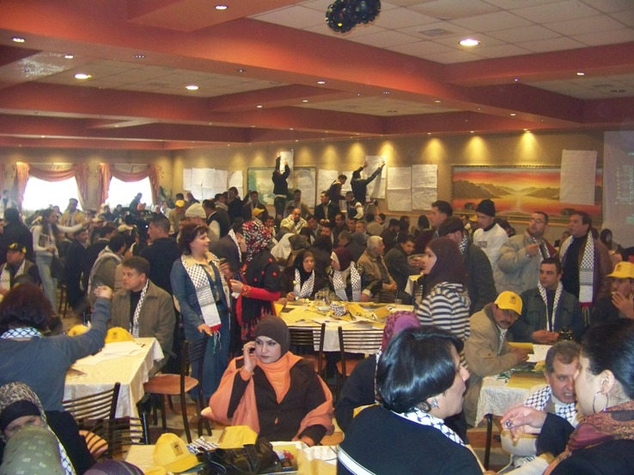
Blue Print for Indigenous Design
A Viable Palestinian State
Bethlehem-2/2/2008

Slide 15
Perspectives on Peace
The Jungle: I Stay Alive “Survival Instincts”
Tribal Cultures: We are Safe “Spirit Voices”
Feudal/Exploitative Cultures: I Rule “Conquest”
Absolutistic/Moralistic : We have Order “Rule of Law”
Enterprising/Rational Cultures: I Thrive. “Negotiations”
Sociocentric/Humanistic Cultures: WE are Equal. “Dialogue”
Existential/Systemic Cultures: I Care and DO “Natural Design”
Holistic/Experiential Cultures: We are conscious of the earth as an organism

Slide 16
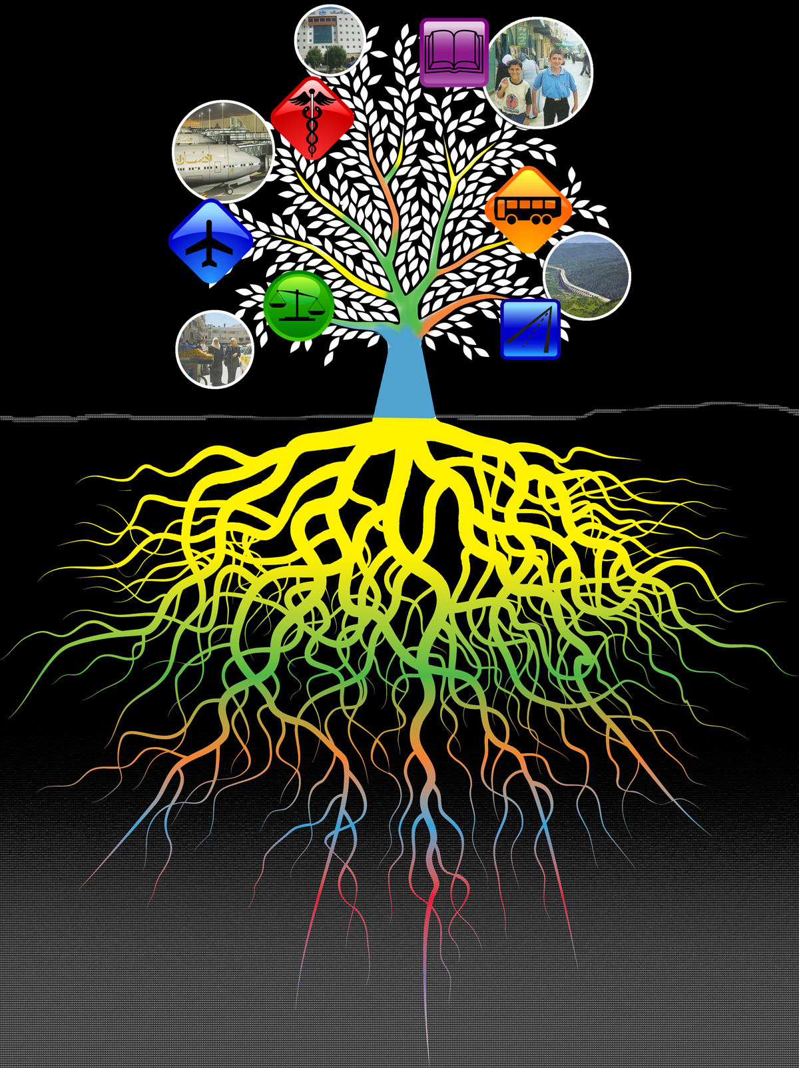
Palestine Department Of Integration
Integrating The Efforts of :
4200 NGOs Western/Local
Public Sector
Private Sector
Memetic Profiles of Palestinians: including Value-Systems/Mindsets/Belief Systems
مركز النهوض بفلسطين
© CHE-Mideast 2012-2013

Slide 17
How this Systemic Framework can contribute to Global emergence

Slide 18
Muslim World Shadow of the West
West Projects its victim-self and oil addiction on the Mideast
Embracing the Collective Unconscious of the West is Key
It releases the Mideast to develop its Next Stages
Rather than a Total Reliance on Oil, the focus of the region will turn to their Precious Resources: Gen Y and Women

Slide 19
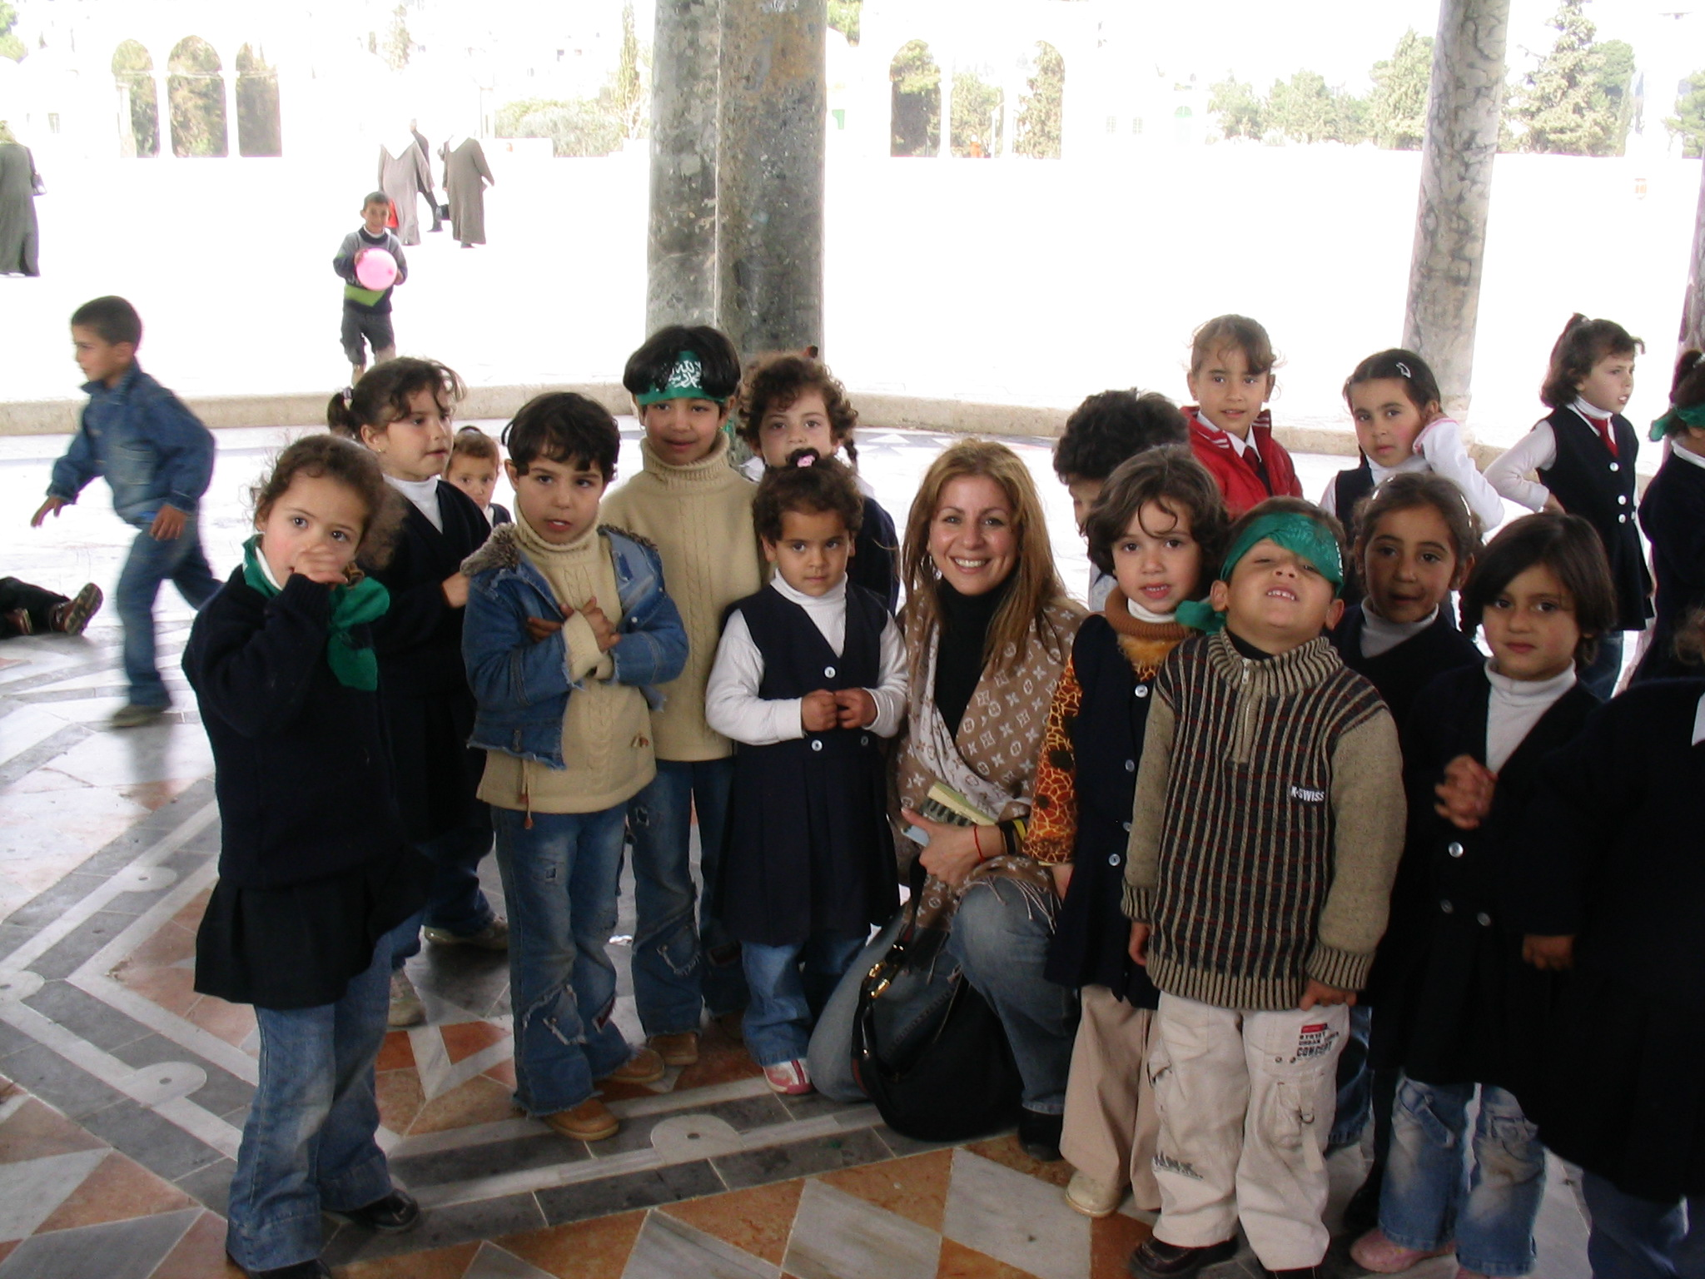
Prepare The EcoSystem for Emergence
© CHE-Mideast 2012-2013

Slide 20
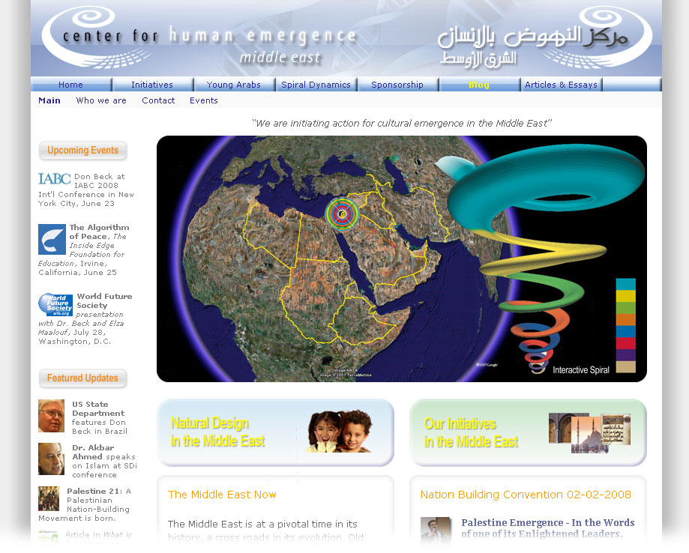
www.CHE-Mideast.org

